Slide 1
Projects
— SA-DF-HE
Week 9^H^H7 is takeaway time!
The hardware is all yours to keep, and (after marking!) you’re welcome to make all your work public (though NOT the whole repository please).
Build something you’ll feel proud showing off at an interview or a makerspace or a party!
COM3505, Lecture 8
Prof Hamish Cunningham

Slide 2
Frequently asked Qs about the project
What was it we were supposed to be doing now again?
Creating! Playing! Making something we might use, or that someone might find useful, or that someone might take pleasure in...
I hate this project!
If you ask nicely you can swap (so long as we have the hardware left). BUT be sure you write up what problems you had and why: the marking scheme includes allocation for documenting your design and development process!
What happens when you put a LiPo in a bag with a featherwing and sit on it?
Nothing good; please be careful!

Slide 3
LiPo: handle and charge carefully
The unPhone contains a Lithium Polymer (LiPo) battery; treat it carefully!
These are potentially dangerous: sign the disclaimer, read the notes — https://iot.unphone.net/#lipo-safety, if in doubt ask!
The two main issues:
handling (don’t break the containment)
charging (the PMU / battery management chip and its programming have been verified by qualified engineers at Adafruit and Pimoroni, but that doesn’t mean they’re infallible, and there is potential for us to break it… take care!)

Slide 4
[from L7] Projects: Marvin, unPhone, LilyGoWatch, or…?
options:
the unPhone
Marvin, a DIY Alexa
LilyGoWatch
roll your own (but check first!)
the spin 9 unPhone is an ESP32S3, LCD with touch display, accelerometer, SD card, LoRaWAN, IR LEDs and vibe motor
possible unPhone projects: remote control of other devices over WiFi or BT, perhaps using a gesture language; voice control via a mic on your other ESP32 (or the expander); exercise tracker; data logger; small-screen UI; fuzzy predictive text; etc. etc. etc.…
with the ML that Valentin introduced last week, lots of Alexa-type projects :)
see also Chapter 8

Slide 5
[From L7] Projects: pros and cons
Project | Advantages | Disadvantages
unPhone | all the elements are pre-soldered (unless you use the expander board) there’s a UI! lots of variations possible | it looks like a phone but… isn’t! [v7 only] relies on patched libraries which can make development (even) trickier
Marvin | close to mass-market products like Alexa, Google Home, etc. good online supporting resources | needs wiring up noise and voice dependent relies on 3rd party services
LilyGO Watch | a wearable! carry a memento of COM3505 everywhere you go! | not a smart watch! translation of docs not perfect
A.N.Other | creativity! | you need to be sure it is A) feasible and B) hard enough

Slide 6
The LilyGoWatch
the LilyGO ESP32 smart[ish]watch v3
there are lots of possible (firmware-based) projects using the watch on its own, especially now that it includes a (basic!) mic
if you want something with a larger hardware component, you could:
connect the watch to your feather (over WiFi or BT or BLE) and use the feather / LED / etc. combination as an actuator (e.g.: turn the TV on or off over IR when I enter the room)
define a project only using the feather (make sure to ok it with me though; you’ll need to have enough to do!)
use some different hardware (next slide)
if you want to minimise the firmware side, then think about pushing data from the watch to the cloud; display your steps on a web dashboard maybe? take notes and add them to a google doc TODO list? ...

Slide 7
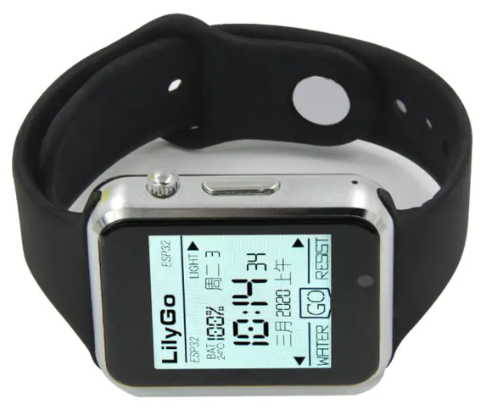
The LilyGoWatch (2)
the LilyGO TTGO SmartWatch v3 is an ESP32 with touch display, mic, accelerometer and vibe motor
possible projects:
exercise tracker
data logger
remote control of other devices over WiFi or BT
perhaps using a gesture language
touch control of your watch via a mic on your feather
small-screen UI
fuzzy predictive text
etc. etc. etc. (just drop me an email first to check scope)
we have around 40 of these

Slide 8
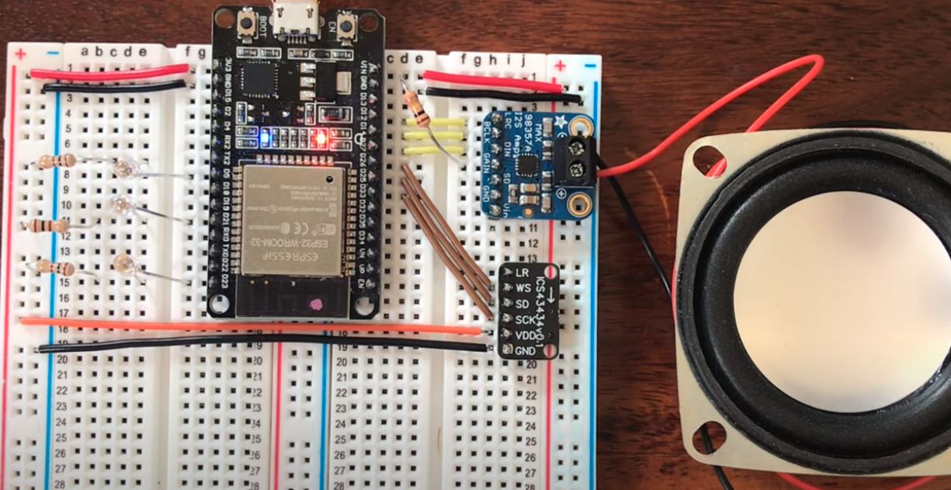
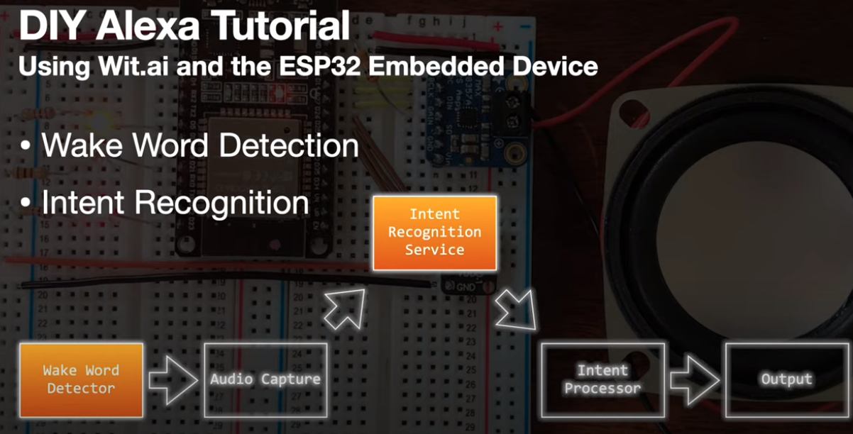
DIY Alexa (Marvin)
Chris Greening has developed a low-noise MEMS mic add-on board for the ESP32
he uses them to build a voice-controlled home automation system, or “DIY Alexa”:
introduction: youtube.com/watch?v=FZ4ayyTXM2s
tutorial: youtube.com/watch?v=re-dSV_a0tM
we have one each of the mics, and speakers and speaker driver boards

Slide 9
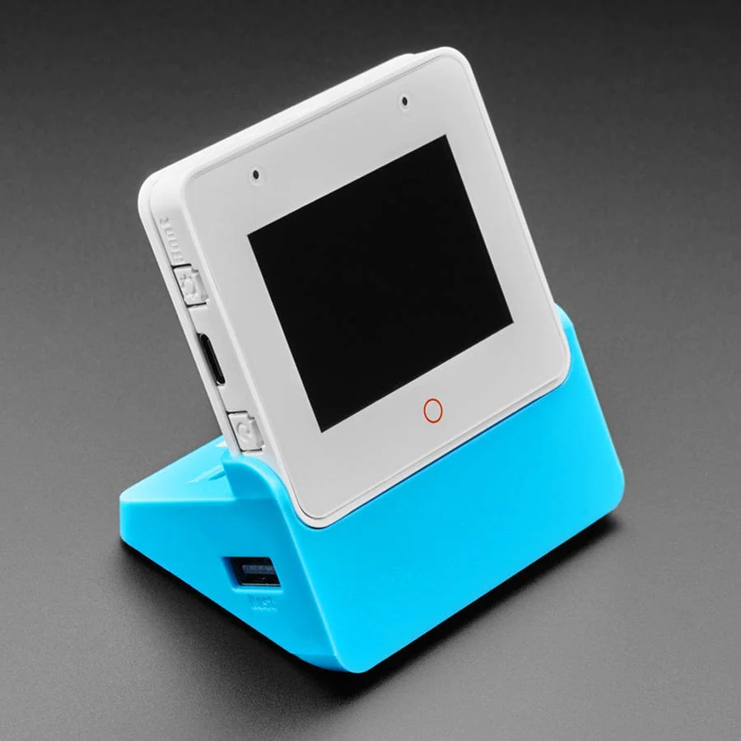
DIY Alexa (Willow)
the Willow project — https://heywillow.io/ — does wakeword, VAD and audio streaming on an ESP-Box (ESP32S3 with 16MB flash RAM)
speech recognition can be done:
on their server (slow!)
via another service like OpenAI whisper or Wit.ai
on an NVidia GPU >= GTX1080 or similar (~8GB VRAM)
there are GPIO pins broken out on the case, and a small touchscreen (with example LVGL code) and loudspeaker
comes in two versions, one with IR and radar sensors
we have 35 or so…

Slide 10
unPhone projects
the spin 9 unPhone is an ESP32S3, LCD with touch display, accelerometer, SD card, LoRaWAN, IR LEDs and vibe motor
possible unPhone projects: Meshtastic off grid messaging; remote control of other devices over WiFi or BT, perhaps using a gesture language; voice control via a mic on your other ESP32 (or the expander); exercise tracker; data logger; small-screen UI; fuzzy predictive text; etc. etc. etc.…
add a secret mic inside the case?
add a featherwing or two? (next slide)
with the ML that Valentin introduced, lots of Alexa-type projects :)
we have lots of unphones :)

Slide 11
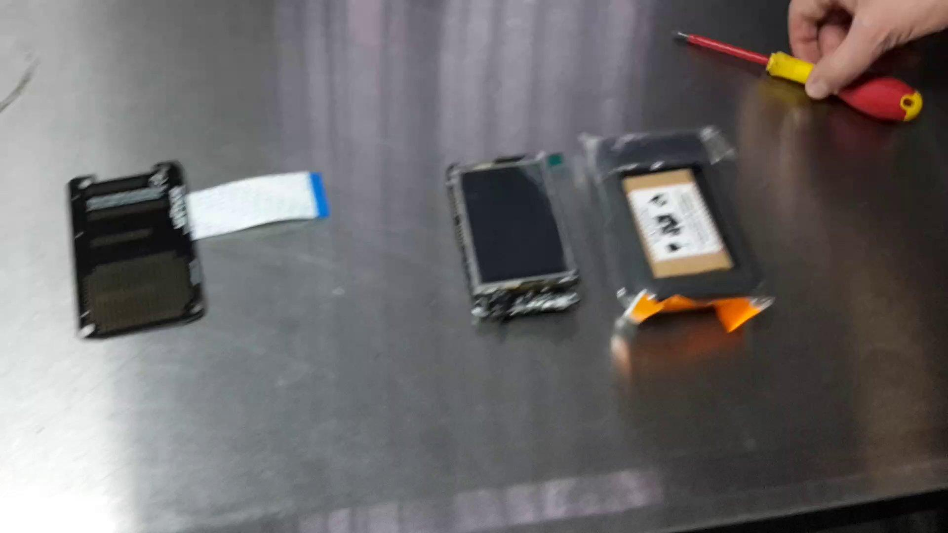
unPhone projects: assembling
TODO v9 update
The expander board provides featherwing sockets and a prototyping area.

Slide 12
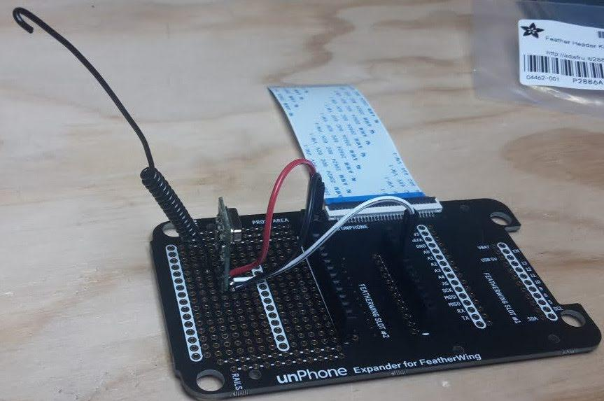
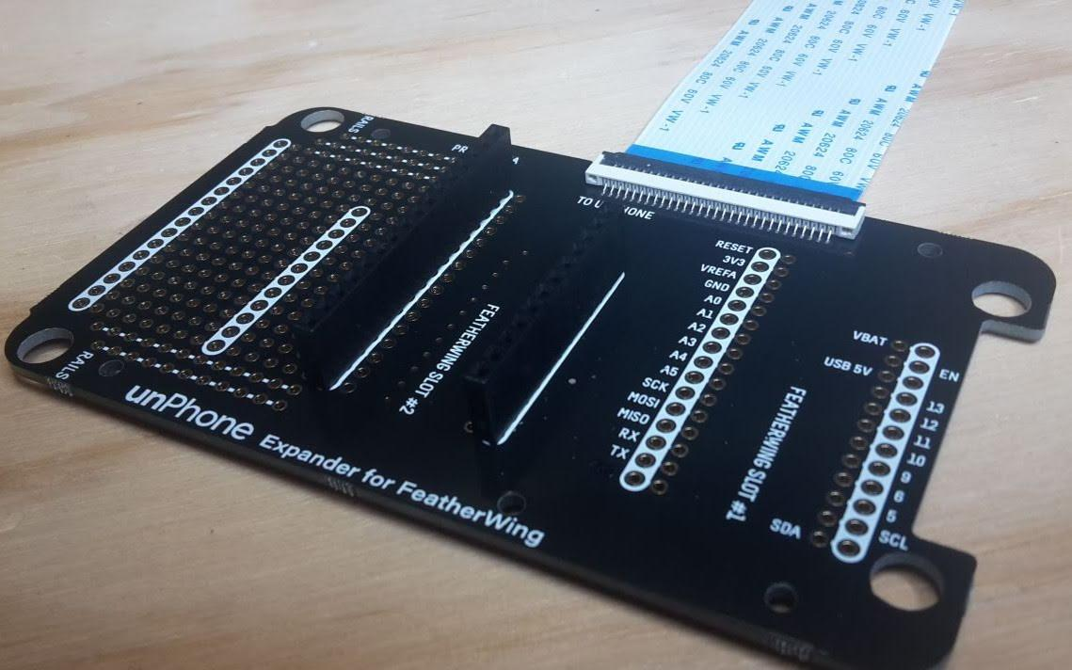
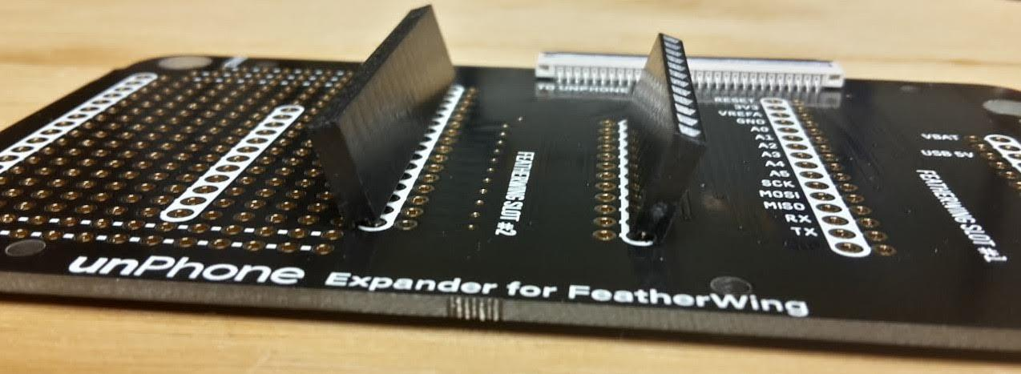
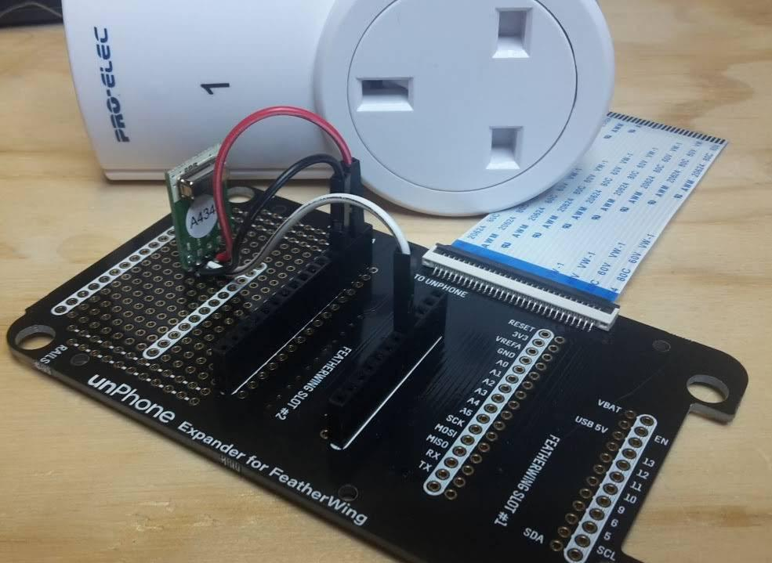
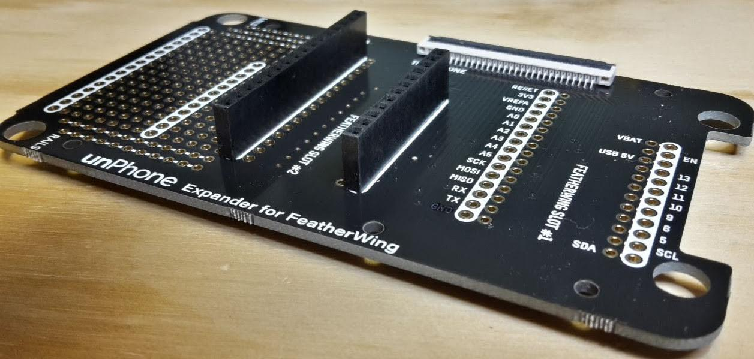
The unPhone’s expander board
The expander board provides featherwing sockets and a prototyping area.
All projects that use additional hardware need to assemble it...
Don’t do this:
Do this:

Slide 13
Other projects available hardware options
Notes:
other bits and pieces may be needed, e.g. cabling
there’s limited time left! you’re welcome to be ambitious, but you do need to keep an eye on the clock!
In stock
AA alkaline batteries
Adafruit I2S 3W Class D Amplifier Breakout - MAX98357A
Mini Speaker 4Ω (3W)
ICS-43434 I2S MEMS Microphone CMG breakout board
GPS featherwing
DS18B20 water temperature sensor
LiPo batteries
SD cards
MP3 featherwing
unPhone spins 7 and 9
NeoPixel featherwing
OLED featherwing
Robocar (inc. motor driver featherwing)
IR sensor
AM2303 air temperature and humidity sensor
Dotstar LED strip 0.5m
Thermal camera featherwing
E-ink featherwing

Slide 14
Robot Car
this project involves some mechanical construction, a little bit of soldering and software
excellent build instructions from Adafruit
the tutorial for using an ESP8266 is easy to adapt to the ESP32
we only have a few of these

Slide 15
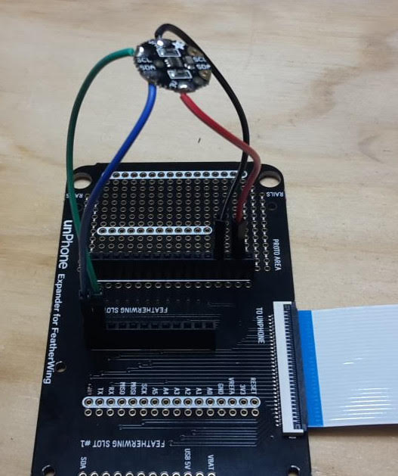
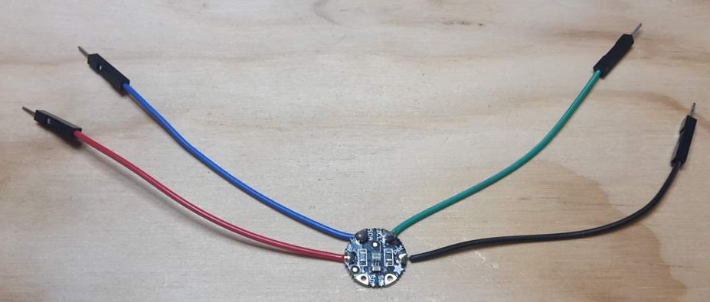
More project options: TV remote / TV-B-Gone
Using the unPhone’s IR LEDs, start by reviewing the TV-B-Gone codes and code inspiration.
We've also got a light sensor that includes an IR photodiode - so you can detect when the IR LED's are on!

Slide 16
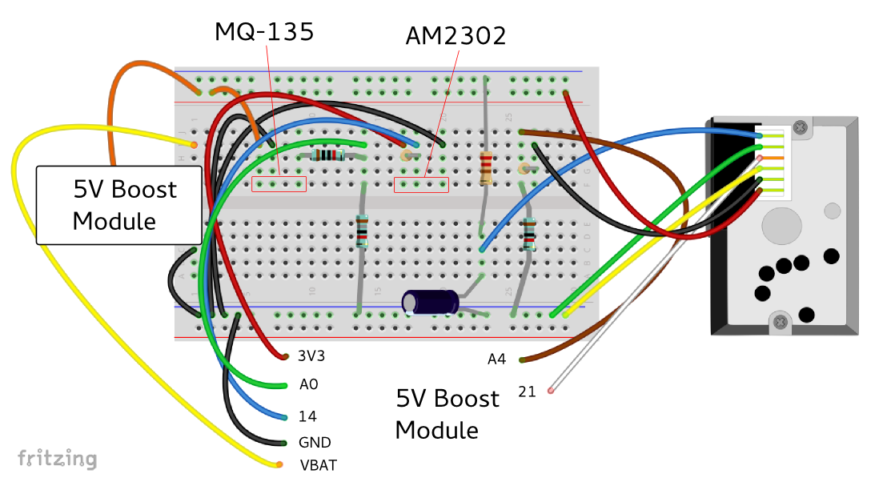
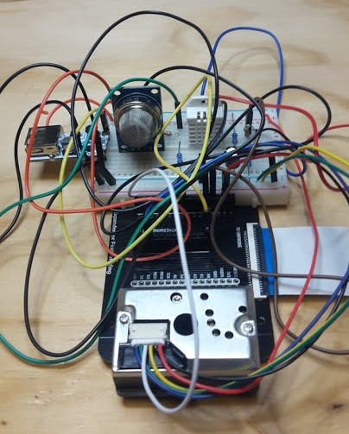
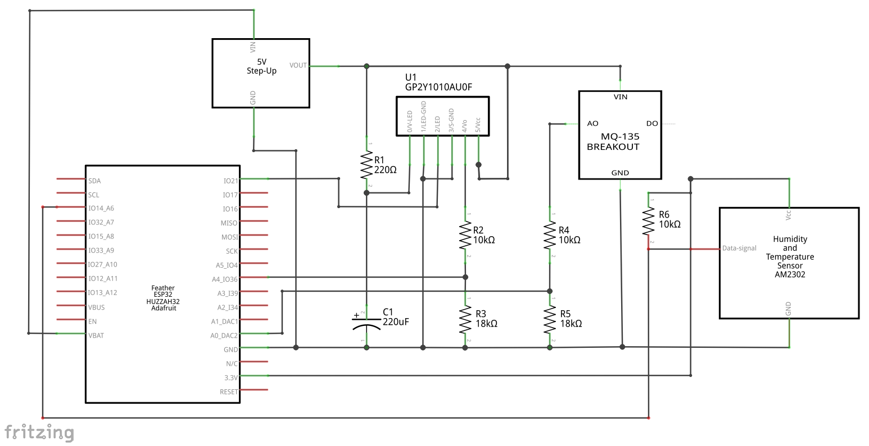
Air Quality Monitor
NOTE: very complex! Not recommended in 2024!
This project uses three sensors to measure various aspects of Air Quality
This project is very complex to wire up!

Slide 17
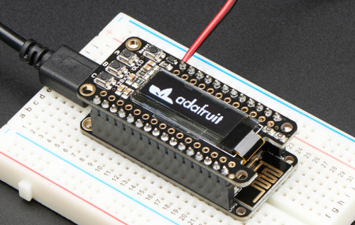
Voting Button
This project involves a little bit of soldering and more software
Device needs to display voting instructions — challenge to use a tiny screen effectively
How do we ensure that everyone gets just one vote, and your vote is cast by you?
An Adafruit library is available for the display

Slide 18
Campus Panic Button
Use Google’s geolocation API to get a lattitude/longitude
Share data in the cloud (Twitter? IFTTT? Adafruit.io? your own server?)
WiFi connection management: copy from Ex09? void setup09() { // joinme wifi UI, with captve portal ... } void loop09() { dnsServer.processNextRequest(); // handle DNS requests webServer.handleClient(); // handle HTTP requests ... }
How secure is it? What sort of UI does it need? Add a button, an LED…?
#include <WifiLocation.h> char* googleApiKey = ""; // TODO put your key here WifiLocation location(googleApiKey); // the location finder ... WiFi.begin("uos-other", "shefotherkey05"); location_t loc = location.getGeoFromWiFi(); if(loc.lat == 0.0 && loc.lon == 0.0) { buf = "Couldn't get locat!\nNo net connection?"; dln(buf); delay(2000); return; } String lat = (String) loc.lat; String lon = (String) loc.lon; buf = "Finding votes at:\n" + lat + " " + lon; dln(buf); dln(netDBG, "location request data"); dln(netDBG, location.getSurroundingWiFiJson()); dln(netDBG, "latitude: " + lat + ", longitude: " + lon); dln(netDBG, "accuracy: " + String(loc.accuracy));

Slide 19
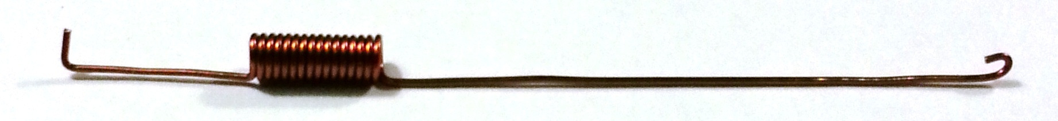
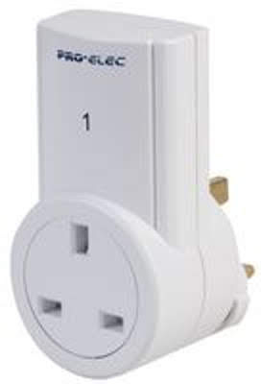

Home Automation
This project adds remote mains power switching to your project using a 433 MHz transmitter and mains socket receiver / relay:
If you have a specific device in mind that uses IR you can also work with the IR LEDs and sensor (as in the TV Remote example above):

Slide 20
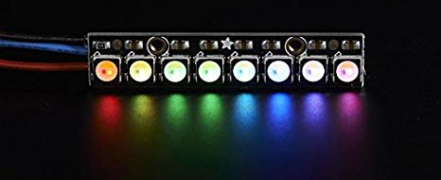
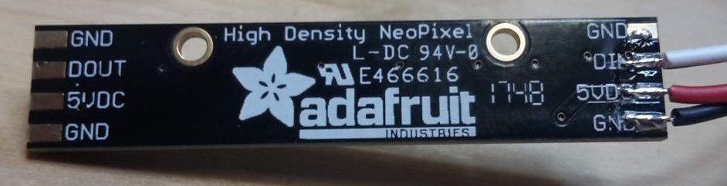
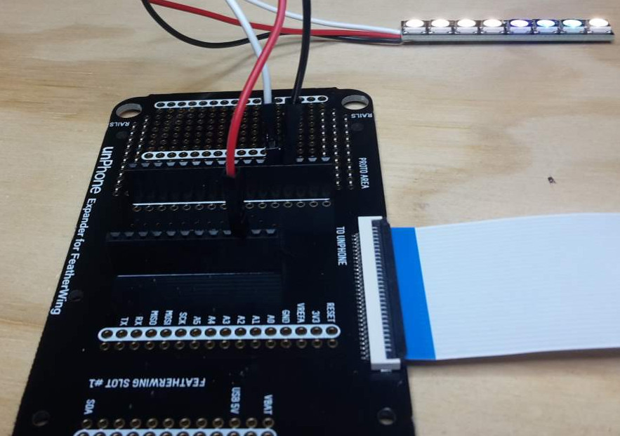
Dawn Simulator Alarm Clock
Adafruit's NeoPixels are bright multicolour LEDs controlled via a single signal wire (plus two for power).
first solder on three connections for power and data
then connect these to the USB 5V, GND and pin A0 as shown

Slide 21
Tiny AI: ChatGPT meets the IoT [advanced!]
The Transformer models that have been trained on the biggest datasets are proving to be a step-change in conversational AI. ChatGPT is the best known at present, and is extremely effective at appearing to be a lucid dialogue partner or (via GitHub co-pilot) a knowledgeable pair programming companion. This is an application of some of the largest computations over the largest data sets that have ever been achieved. Many things are set to change as a result.
The IoT, on the other hand, is about the application of our smallest units of computation to networked microcontrollers. Special purpose devices combine sensors and actuators, expose control surfaces of various types, and communicate with local hubs and/or cloud analytics and control.
This project: using a mic and speech recognition, or an on-screen keyboard, make an ESP32 interface to ChatGPT.

Slide 22
Yet more projects...
MP3 player
The unPhone includes a VS1053 MP3 decoder chip which can also do a nice job of synthesising MIDI input. Store your.mp3 files on the SD card that came with your unPhone (after formatting it to FAT), and see the example code for how to play via the headphone jack.
Note that streaming audio is a blocking operation for at least one of the ESP32's cores, so your UI will have to find clever ways to squeeze into available processing power!
Predictive text UI
See the Predictor examples in the template sketches.
Musical instrument
Using the VS1053's MIDI synthesis capability and e.g. the accelerometer as a control mechanisms many musical instruments become possible.
Bedtime tracker
Eyes drooping? C programming not seeming quite as exciting as usual? Perhaps you should be getting more sleep :) How to track your screen-off shut-eye time and present the data back in an easy to interpret form?
Battleships game
This is a popular game with simple UI requirements, perfect for a connected microcontroller like the ESP32.

Slide 23
Additional hardware: kit lists
unPhone projects with external components:
unPhone expander board
Dawn simulator:
NeoPixel LEDs
Home automation:
433 MHz transmitter board
mains socket switch
30cm length of wire for arial
Air Quality:
Sharp dust sensor
MQ-135 gas sensor
Air Quality contd.:
AM2302 Humidity sensor
5v boost power supply
4x10k resistors
2x3.3k resistors
1x220R resistor
1x220uF capacitor
Dust sensor cable
Breadboard
Jumper cables
2x pin headers
Sticky tape
Robot Car:
Robot chassis and motor kit
Motor driver feather
Battery box
4xAA batteries
4xlong pin headers
4 Sticky pads
Others:
we have switches, LEDs, resistors, etc. — just ask

Slide 24
Design, Build, Demo
When you've chosen a project you need to start:
documenting your design
building any extra hardware that is needed
working on the firmware
thinking about how you will test the project
thinking about how you will demo the project
This will form the qualitative (grading) element of your course assessment...

Slide 25
LA2 (project) assessment
This is an advanced course and the project assessment in particular is
intentionally open-ended. There is no single right answer! (And almost certainly no perfect answer!)
Deadline. The Friday of week 12 at midday UK time.
Size. If you have spent e.g. 8 hours per week on the work so far, you should be able to achieve a good solution if you allocate a similar amount of time to the project each week until the end of the semester.
Marks. The assessment is marked out of 100 and contributes a possible
maximum of 60 to your score for the course. LA1 and the exam are pass/fail threshold elements of your assessment; LA2 dictates your grade after passing the other two. It is possible to pass the course without completing LA2, in which case your mark will be 40.

Slide 26
Projects: summary
do something fun!
do something to demo to other people later on
be creative!

